Slide 1

---------------------- HSV RETROGRADE
--------------- HSV RETROGRADE SCHEDULE
EVENT | DATE | TIME
ARRIVE ---------------
ONLOAD CARGO
ONLOAD PAX
DEPART ----------------
(-------- PORT – -------- PORT)
ITEM | QTY
CONTAINERS
VEHICLES
TRAILERS
463L
ECUs
GENERATORS
FLOOD LIGHT
TOTAL#
PAX/CARGO ROLLUP
# OF PAX
# OF CARGO
PAX S/T | S/T
CARGO S/T | S/T
TOTAL S/T | S/T
UNCLASS

Slide 2
------------------------- HSV RETROGRADE
UIC | NSN | PKG ID | ITEM ID | DESCRIPTION | WEIGTH | LENGTH | WIDTH | HEIGHT | JCS | remarks
M21635 | 2320014559593 | 606088 | D1158 | TRK, UTILITY, CARGO TRP CARR 1 1/4 TON W/EQUIP, HM | 7700 | 183 | 91 | 84 | R2D
M21635 | 2320014559593 | 609993 | D1158 | TRK, UTILITY, CARGO TRP CARR 1 1/4 TON W/EQUIP, HM | 8210 | 183 | 91 | 84 | R2D
M21635 | 2320014559593 | 612847 | D1158 | TRK, UTILITY, CARGO TRP CARR 1 1/4 TON W/EQUIP, HM | 7500 | 183 | 91 | 84 | R2D
M21635 | 2320014559593 | 620402 | D1158 | TRK, UTILITY, CARGO TRP CARR 1 1/4 TON W/EQUIP, HM | 7580 | 183 | 91 | 84 | R2D
M21635 | 2330015435794 | 635300 | D0017 | M1102 TRAILER | 3380 | 135 | 88 | 76 | A2D | (2) GENERATORS B130462047 & B130462050 LOAD ONTO
M21635 | 2330015435794 | 636064 | D0017 | M1102 TRAILER | 2780 | 135 | 88 | 91 | A2D | (1) GENERATOR E130498555 LOAD ONTO
M21635 | 2330015435794 | 637047 | D0017 | M1102 TRAILER | 3360 | 135 | 88 | 91 | A2D | (2) GENERATORS B130462100 & B130462101 LOAD ONTO
M21635 | 2330015435794 | 637071 | D0017 | M1102 TRAILER | 2830 | 135 | 88 | 91 | A2D | (1) GENERATOR E130498570 LOAD ONTO
M21635 | 3805015497814 | 105150 | B0063 | TRACTOR, RUBBER-TIRED, ARTICULATED STEERING, MULTI-PURPOSE | 41320 | 258 | 104 | 132 | A2D
M21635 | 4120015811276 | GL33971 | B0014 | ENVIRONMENTAL CONTROL UNIT | 520 | 37 | 48 | 43 | J3B
M21635 | 4120015811276 | GL33505 | B0014 | ENVIRONMENTAL CONTROL UNIT | 530 | 37 | 48 | 43 | J3B
M21635 | 4120015811276 | GL33617 | B0014 | ENVIRONMENTAL CONTROL UNIT | 510 | 37 | 48 | 43 | J3B
M21635 | 4120015811276 | GL33644 | B0014 | ENVIRONMENTAL CONTROL UNIT | 530 | 37 | 48 | 43 | J3B
M21635 | 4120015811276 | GL33871 | B0014 | ENVIRONMENTAL CONTROL UNIT | 520 | 37 | 48 | 43 | J3B
M21635 | 5411012949866 | 0205 | A2333 | SHELTER, TACTICAL EXPANDABLE, TWO-SIDED | 6020 | 240 | 96 | 96 | J2D
M21635 | 5820015505231 | 609251 | A2179 | TRC-170 | 10150 | 192 | 89 | 106 | R1D
M21635 | 5820015505231 | 620393 | A2179 | TRC-170 | 10460 | 192 | 89 | 106 | R1D
M21635 | 5820015505231 | 620864 | A2179 | TRC-170 | 10400 | 192 | 89 | 106 | R1D
M21635 | 5820015505231 | 620417 | A2179 | TRC-170 | 10950 | 192 | 89 | 106 | R1D
M21635 | 5820015505231 | 631829 | A2179 | TRC-170 | 11540 | 192 | 89 | 106 | R1D
M21635 | 5820015505231 | 564352 | A2179 | TRC-170 TRAILER | 3310 | 155 | 89 | 94 | R1D
M21635 | 5820015505231 | 564358 | A2179 | TRC-170 TRAILER | 3370 | 155 | 89 | 94 | R1D
M21635 | 5820015505231 | 564379 | A2179 | TRC-170 TRAILER | 3360 | 155 | 89 | 94 | R1D
M21635 | 5820015505231 | 567332 | A2179 | TRC-170 TRAILER | 3360 | 155 | 89 | 94 | R1D
M21635 | 5820015505231 | M10016 | A2179 | TRC-170 TRAILER | 3060 | 155 | 89 | 94 | R1D
M21635 | 8115014747089 | USMC0201879 | C4433 | 7TH COMM QUADCON | 5710 | 96 | 60 | 84 | J2D
M21635 | 8115014747089 | USMC0202089 | C4433 | 7TH COMM QUADCON | 4990 | 96 | 60 | 84 | J2D
M21635 | 8115014747089 | USMC0233388 | C4433 | 7TH COMM QUADCON | 6290 | 96 | 60 | 84 | J2D
M21635 | 8115014747089 | USMC110408-7 | C4433 | 7TH COMM QUADCON | 4710 | 96 | 60 | 84 | J2D
UNCLASS

Slide 3
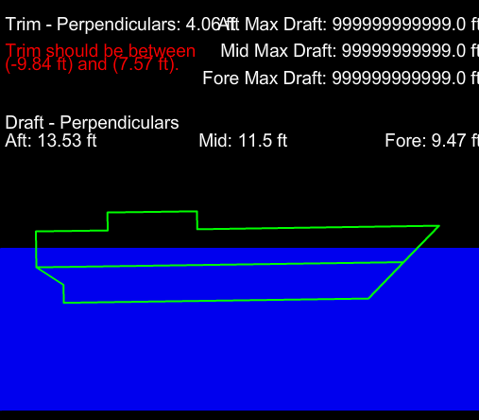
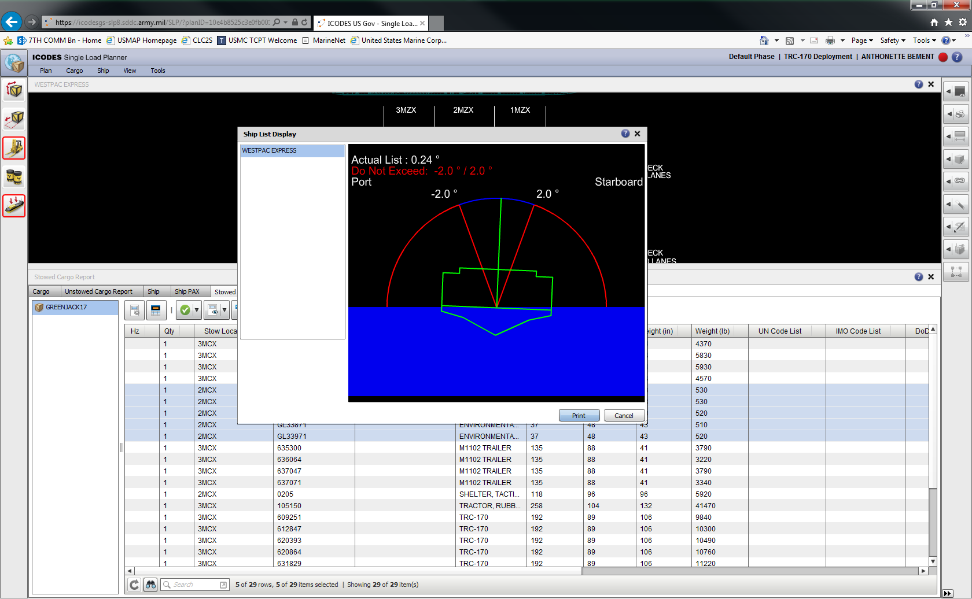
-------------------------------- HSV RETROGRADE
TRIM AND LIST
UNCLASS

Slide 4
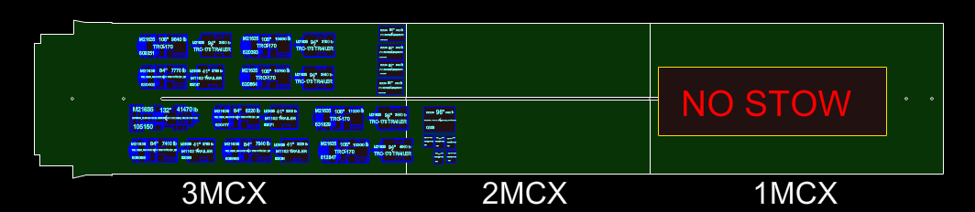
----------------------------------- HSV RETROGRADE
MAINDECK CENTER LANES
ITEM | QTY
CONTAINERS
VEHICLES
TRAILERS
463L
ECUs
GENERATORS
FLOOD LIGHT
TOTAL#
UNCLASS

Slide 5
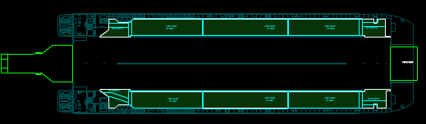
--------------------------- HSV RETROGRADE
MAINDECK OUTBOARD LANES
ITEM | QTY
VEHICLES | 0
TRAILERS | 0
TOTAL# | 0
UNCLASS

Slide 6
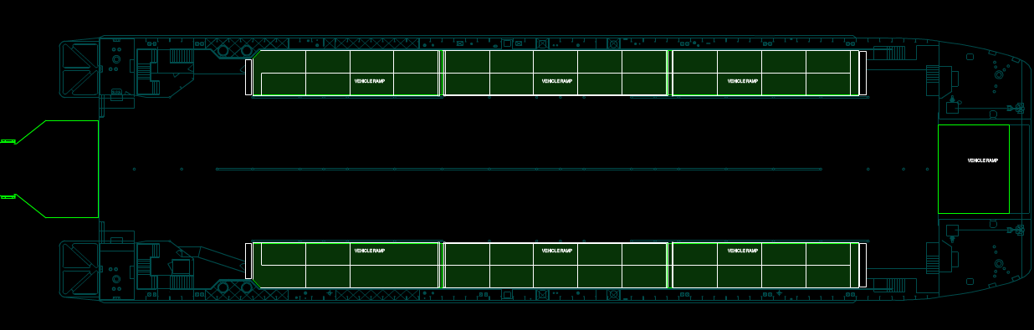

------------------------- HSV RETROGRADE
MEZZANNE DECK
UNCLASS

